Slide 1
MONOPOLY

Slide 2
Monopoly
While a competitive firm is a price taker, a monopoly firm is a price maker.
A firm is considered a monopoly if . . .
  it is the sole seller of its product.
  its product does not have close substitutes.

Slide 3
WHY MONOPOLIES ARISE
The fundamental cause of monopoly is barriers to entry.
Barriers to entry have three sources:
  Ownership of a key resource.
  The government gives a single firm the exclusive right to produce some good.
  Costs of production make a single producer more efficient than a large number of producers.

Slide 4
Monopoly Resources
Exclusive ownership of a key resource is a potential source of monopoly, in practice sometimes temporary monopolies arise for this reason.

Slide 5
Government Created Monopolies
Governments may restrict entry by giving a single firm the exclusive right to sell a particular good in certain markets.
Patent and copyright laws are two important examples of how government creates a monopoly to serve the public interest.

Slide 6
Natural Monopolies
An industry is a natural monopoly when a single firm can supply a good or service to an entire market at a smaller cost than could two or more firms.
A natural monopoly arises when there are economies of scale over the relevant range of output.

Slide 7

Economies of Scale as a Cause of Monopoly
Cost
Average
total
cost
0
Quantity of Output

Slide 8
HOW MONOPOLIES MAKE PRODUCTION AND PRICING DECISIONS
Monopoly versus Competition
  Monopoly
    Is the sole producer
    Faces a downward-sloping demand curve
    Is a price maker
    Reduces price to increase sales
  Competitive Firm
    Is one of many producers
    Faces a horizontal demand curve
    Is a price taker
    Sells as much or as little at same price

Slide 9
Demand Curves for Competitive and Monopoly Firms
(a) A Competitive Firm
’
s Demand Curve
(b) A Monopolist
’
s Demand Curve
Price
Price
Demand
Demand
0
Quantity of Output
0
Quantity of Output

Slide 10
A Monopoly’s Revenue
Total Revenue
P × Q = TR
Average Revenue
TR/Q = AR = P
Marginal Revenue
ΔTR/ΔQ = MR

Slide 11
A Monopoly’s Revenue
A Monopoly’s Marginal Revenue
  A monopolist’s marginal revenue is always less than the price of its good.
    The demand curve is downward sloping.
    MR = P(1 – 1/|E_{P}|)

Slide 12
A Monopoly’s Revenue
A Monopoly’s Marginal Revenue
  When a monopoly increases the amount it sells, it has two effects on total revenue (P × Q).
    The output effect—more output is sold, so Q is higher.
    The price effect—price falls, so P is lower.
    That is, TR increases at a decreasing rate. MR declines.

Slide 13
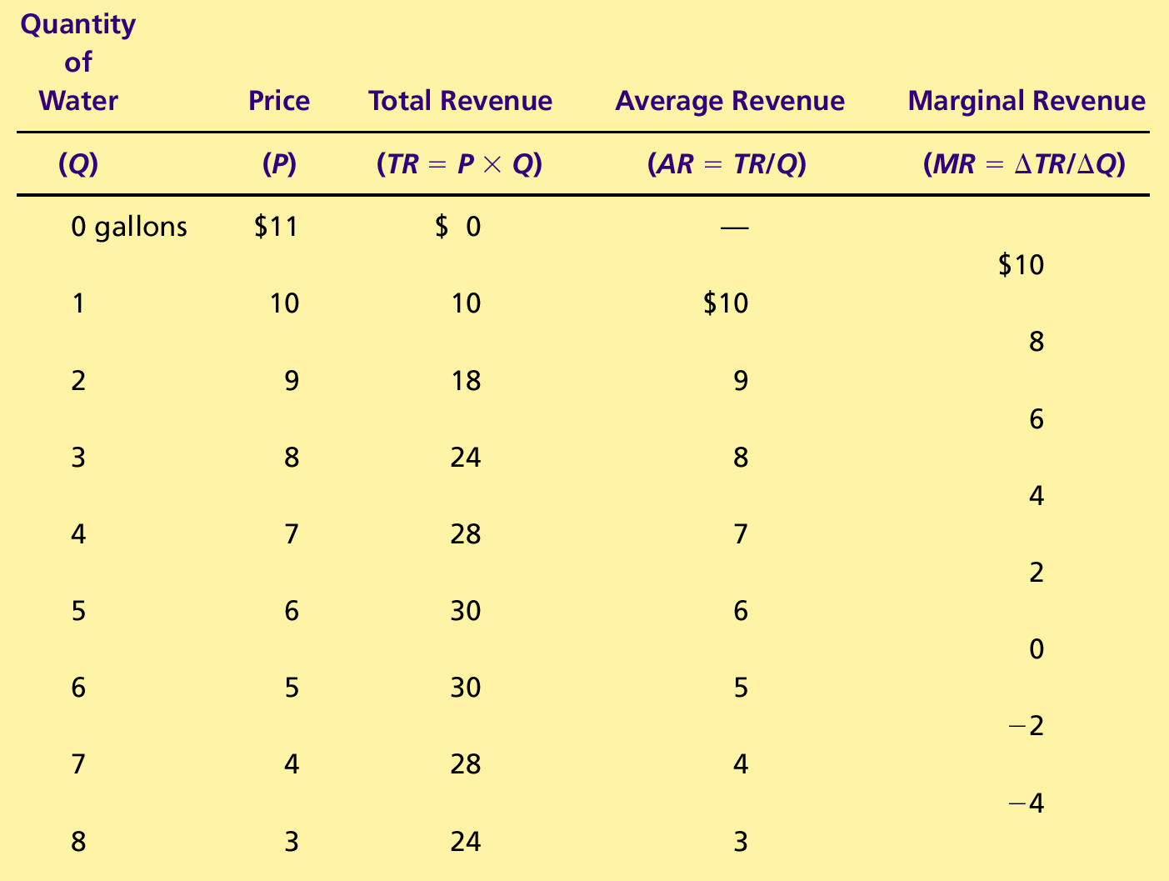
A Monopoly’s Total, Average, & Marginal Revenue

Slide 14
Demand and Marginal-Revenue Curves for a Monopoly
Price
Rs11
10
9
8
7
6
5
4
3
Demand
2
Marginal
(average
1
revenue
revenue)
0
–1
1
2
3
4
5
6
7
8
Quantity of Water
–2
–3
–4

Slide 15
Profit Maximisation
A monopoly maximizes profit by producing the quantity at which marginal revenue equals marginal cost.
It then uses the demand curve to find the price at which he will sell that quantity to consumers.

Slide 16
Profit Maximization for a Monopoly
Costs and
Revenue
2. . . . and then the demand
1. The intersection of the
curve shows the price
marginal-revenue curve
consistent with this quantity.
and the marginal-cost
curve determines the
B
profit-maximizing
Monopoly
quantity . . .
price
Average total cost
A
Marginal
Demand
cost
Marginal revenue
0
Q
Q_{MAX}
Q
Quantity

Slide 17
Profit Maximisation
Comparing Monopoly and Competition
  For a competitive firm, price equals marginal cost.
  P = MR = MC
  For a monopoly firm, price exceeds marginal cost.
  P > MR (= MC)

Slide 18
A Monopoly’s Profit
Profit equals total revenue minus total costs.
  Profit = TR – TC
  Profit = (TR/Q - TC/Q) × Q
  Profit = (P - ATC) × Q

Slide 19
The Monopolist’s Profit
Costs and
Revenue
Marginal cost
Monopoly
E
B
price
Monopoly
Average total cost
profit
Average
total
D
C
cost
Demand
Marginal revenue
0
Q_{MAX}
Quantity

Slide 20
A Monopolist’s Profit
The monopolist will receive economic profits as long as price is greater than average total cost.

Slide 21
A Monopolist Always Operates In The Elastic Portion Of Its Demand Curve
P
Elastic
Unitary
Inelastic
Demand
Q
Total
Revenue
(Rs)
MR
Q
MR = P(1 – 1/ E_{P} )

Slide 22
Monopoly : Shift in Demand Leads to
Change in Price but Same Output
Rs/Q
MC
P₁
P₂
D₂
D₁
MR₂
MR₁
Q₁= Q₂
Quantity

Slide 23
Monopoly : Shift in Demand Leads to
Change in Output but Same Price
Rs/Q
MC
P₁ = P₂
D₂
MR₂
D₁
MR₁
Q₁
Q₂
Quantity

Slide 24
Monopoly
Observations
  Monopolist may supply many different quantities at the same price.
  Monopolist may supply the same quantity at different prices.
Notes:
3

Slide 25
Monopoly
The Monopolist’s demand curve
  downward sloping
  MR below AR
Equilibrium price and output
  Equilibrium output, where MC = MR
  Equilibrium price, found from demand curve
Profit
  Measuring profit
  Supernormal profit can persist in long run

Slide 26
Monopoly
Disadvantages of monopoly
  high prices / low output: short run

Slide 27
Equilibrium of industry under perfect competition and monopoly: with the same MC curve
Rs
MC
Monopoly
P₁
AR = D
MR
O
Q₁
Q

Slide 28
Equilibrium of industry under perfect competition and monopoly: with the same MC curve
Rs
MC ( = supply under
perfect competition)
Comparison with
Perfect competition
P₁
P₂
AR = D
MR
O
Q₁
Q₂
Q

Slide 29
Monopoly
Disadvantages of monopoly
  high prices / low output: short run
  high prices / low output: long run

Slide 30
Monopoly
Disadvantages of monopoly
  high prices / low output: short run
  high prices / low output: long run
  lack of incentive to innovate

Slide 31
Monopoly
Disadvantages of monopoly
  high prices / low output: short run
  high prices / low output: long run
  lack of incentive to innovate
Advantages of monopoly

Slide 32
Monopoly
Disadvantages of monopoly
  high prices / low output: short run
  high prices / low output: long run
  lack of incentive to innovate
Advantages of monopoly
  economies of scale

Slide 33
Monopoly
Disadvantages of monopoly
  high prices / low output: short run
  high prices / low output: long run
  lack of incentive to innovate
Advantages of monopoly
  economies of scale
  profits can be used for investment

Slide 34
Monopoly
Disadvantages of monopoly
  high prices / low output: short run
  high prices / low output: long run
  lack of incentive to innovate
Advantages of monopoly
  economies of scale
  profits can be used for investment
  high profits encourage risk taking

Slide 35
Examples Of Monopolies
US Steel not allowed to acquire National Steel in 1984 by antitrust. Takeover occurred in 2003 when National Steel was declared bankrupt.
Standard Oil, broken up in 1911.
United Aircraft and Transport Corporation, aircraft manufacturer holding company, forced to divest itself of airlines in 1934.
AT&T, telecom giant broken up in 1984.

Slide 36
Examples Of Monopolies
Microsoft; settled antitrust litigation in US in 2001; fined by European Commission in 2004, which was upheld by the Court of First Instance of the European Communities in 2007. The fine was 1.35 billion USD in 2008 for incompliance with the 2004 rule.
DeBeers settled charges of price fixing in diamond trade in 2000s.
Monsanto; sued several times by competitors for anti-competitive and monopolistic practices; holds between 70-100% of commercial seed market.

Slide 37
THE WELFARE COST OF MONOPOLY
In contrast to a competitive firm, the monopoly charges a price above the marginal cost.
From the standpoint of consumers, this high price makes monopoly undesirable.
However, from the standpoint of the owners of the firm, the high price makes monopoly very desirable.

Slide 38
The Efficient Level of Output
Price
Marginal cost
Value
Cost
to
to
buyers
monopolist
Demand
Cost
Value
(value to buyers)
to
to
monopolist
buyers
0
Quantity
Value to buyers
Value to buyers
is greater than
is less than
cost to seller.
cost to seller.
Efficient
quantity

Slide 39
The Deadweight Loss
Because a monopoly sets its price above marginal cost, it places a wedge between the consumer’s willingness to pay and the producer’s cost.
  This wedge causes the quantity sold to fall short of the social optimum.

Slide 40
The Inefficiency of Monopoly
Price
Deadweight
Marginal cost
loss
Monopoly
price
Marginal
revenue
Demand
0
Monopoly
Efficient
Quantity
quantity
quantity

Slide 41
Deadweight Loss from Monopoly Power
Rs/Q
Because of the higher
price, consumers lose
A+B and producer
gains A-C.
Lost Consumer Surplus
D
Deadweight
Loss
P_{m}
MC
A
B
P_{C}
C
E
AR
MR
Q_{m}
Q_{C}
Quantity

Slide 42
The Deadweight Loss
The Inefficiency of Monopoly
  The monopolist produces less than the socially efficient quantity of output.

Slide 43
Why Government Dislikes Monopoly?
P > MC
  Too little output, at too high a price
Deadweight loss of monopoly

Slide 44
Monopoly Power
Monopoly is rare.
However, a market with several firms, each facing a downward sloping demand curve will produce so that price exceeds marginal cost.

Slide 45
Monopoly Power
Measuring Monopoly Power
  In perfect competition: P = MR = MC
  Monopoly power: P > MC

Slide 46
Monopoly Power
Lerner’s Index of Monopoly Power
  L = (P - MC)/P
    The larger the value of L (between 0 and 1) the greater the monopoly power.
  L is expressed in terms of E_{d}
    L = (P - MC)/P = 1/ E_{d}
    E_{d} is elasticity of demand for a firm, not the market.

Slide 47
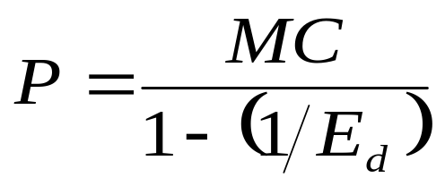
Monopoly Power
    L = (P - MC)/P = 1/ E_{d}
    -Pricing for any firm with monopoly power
    If E_{d} is large, monopoly power is small,
    i.e (P-MC/ P) is small.
    If E_{d} is small, monopoly power is large,
    i.e (P-MC/ P) is large.
From L index we can calculate the profit max. price.

Slide 48
Sources of Monopoly Power
Why do some firm’s have considerable monopoly power, and others have little or none?
A firm’s monopoly power is determined by the firm’s elasticity of demand.

Slide 49
Sources of Monopoly Power
The firm’s elasticity of demand is determined by:
1) availability and closeness of substitutes.
2) nature of product.

Slide 50
A Numerical Example
Given estimates of
    P = 10 - Q
    C(Q) = 6 + 2Q
Calculate The Following –
Optimal output?
Optimal price?
Maximum profits?

